Slide 1
QUANTITY COMPUTING
CRISTIAN RENGIFO

Slide 2
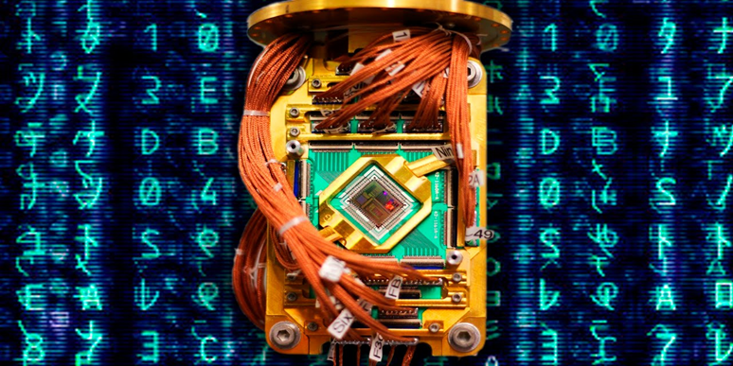
QUANTITY COMPUTING
Quantum computing is a paradigm of computing different from that of classical computing. It is based on the use of cubes instead of bits, and gives rise to new logical gates that make possible new algorithms.

Slide 3
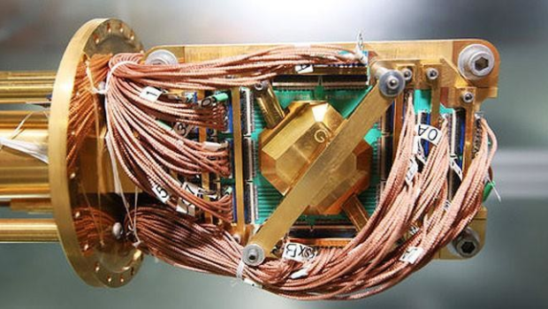
ORIGIN OF QUANTITY COMPUTING
The idea of ​​quantum computing arose in 1981, when Paul Benioff presented his theory to take advantage of quantum laws in the computing environment. Instead of working at the level of electrical voltages, work at the level of how much.

Slide 4


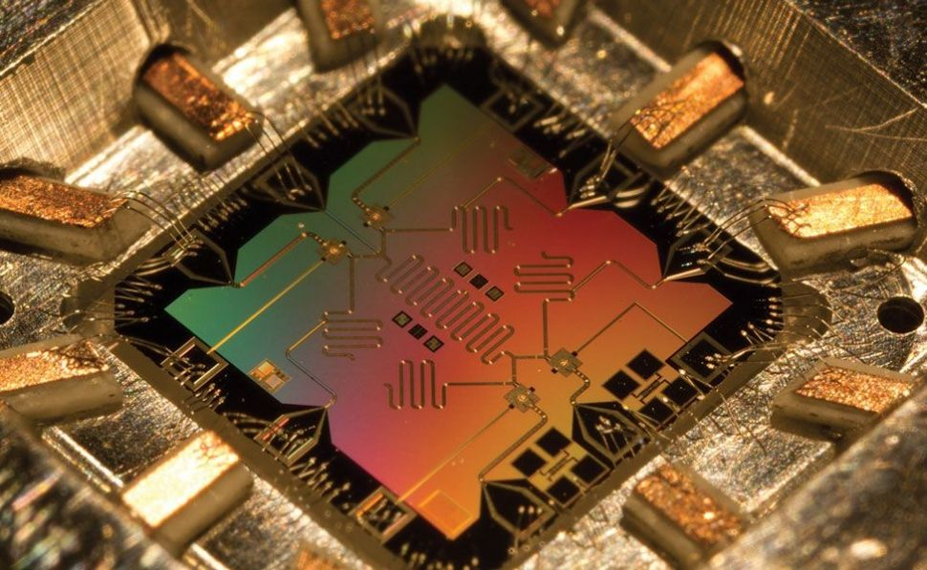
INFOGRAPHY – INFOGRAFIA
ALGORITMO CUANTICO:
ALGORITMO DE SHORT
ALGORITMO DE GROVER
ALGORITMO DE DEUTCSH-JOZSA
QUANTUM ALGORITHM:
SHORT ALGORITHM
GROVER ALGORITHM
ALGORITHM OF DEUTCSH-JOZSA
PROBLEMAS DE LA COMPUTACION CUANTICA:
EL HARWARE ADECUADO
LA COHERENCIA DE LOS PASOS DE ALGORITMO
EL INCREMENTO DE CUBITS
PROBLEMS OF QUANTITY COMPUTING:
THE RIGHT HARWARE
THE COHERENCE OF THE STEPS OF ALGORITHM
THE INCREMENT OF CUBITS
MODELOS:
COMPUTADORA CUANTICA DE BENIOUFF
COMPUTADORA CUANTICA DE FEYNMAN
COMPUTADORA CUANTICA DE DEUTSCH
MODELS:
BENIUFF QUANTUM COMPUTER
FEYNMAN QUANTUM COMPUTER
DEUTSCH QUANTUM COMPUTER

